Slide 1
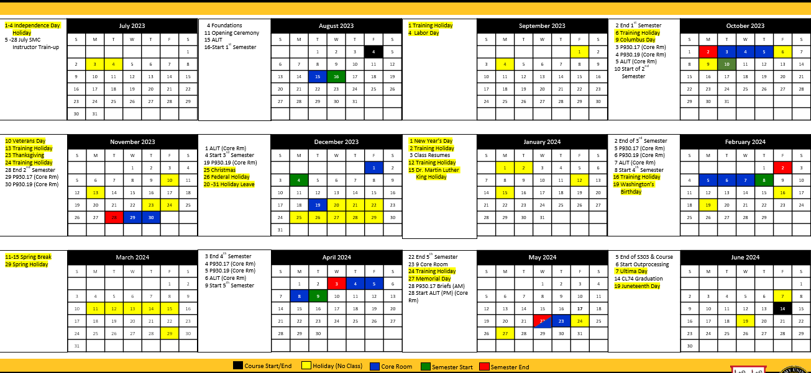
Academic Calendar
Notes:
https://www.ncoworldwide.army.mil/Portals/76/courses/smc/images/Class%2073%20Calendar_16%20Feb%202022.png?ver=YZFwgNPW1z8cHavOQuVUkA%3d%3d

